Slide 1
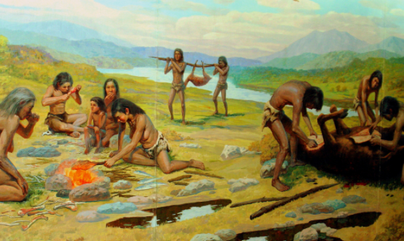
Ch 19 Human Ancestors
Transition to Modern Humans

Slide 2
Homo heidelbergensis / antecessor
Fossils
found in Africa (dated to 1 mya)
Found in Europe (dated to 500 000 years ago)
Features between H. erectus and H. sapiens
Possible common ancestor of Humans and Neanderthals
Modern skull contours and teeth
Not enough fossil evidence to fully understand relationships between different Homo species.
Family tree has more branches than at first thought – just all extinct.

Slide 3
Neanderthals
First fossils found in 1856 in Neander Valley, Germany
Many more fossils found since
Side branch along pathway to modern humans – we share a common ancestor
DNA shows a distinct biological species:
Homo neanderthalensis
Existed in europe during the last ice age – adapted
Neanderthals and Homo sapiens coexisted in europe, may have inter-bred

Slide 4
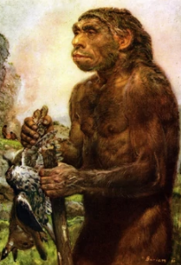
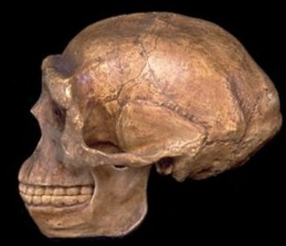
Neanderthals
Features include:
Big faces
Low but large skulls – back of skull drawn out into “bun”
Heavy brow ridges
Lack of defined chin
Cheeks swept back
Prognathic jaw
Likely to have very prominent, wide nose – adaptation for cold, dry
Solid frame
Probably walked, ran and used hands in way very similar to modern humans

Slide 5
Modern Humans
1868: fossils found at Cro-Magnon in France
Five people
Animal bones
Sea shell necklaces
Stone tools
Part of widespread population in Europe from 40 000 years ago to 12 000 years ago.
Members of Homo sapiens
Less prominent brow ridges
Shorter, rounder skulls
Flatter face
Smaller jaw, smaller teeth
Chin
Large brain
Well separated eye sockets

Slide 6
